Slide 1
Budgetary Affairs, 24 Jan 2019
Referrals in this report:
Current and next FY budget (continuing).
Report on the distribution of raises given to administrators, faculty, and staff, respectively (note that this query is old enough that it was focused on FY 17/FY 18).
Other referrals:
What is System’s source for $260 million? [Curator Steelman: “Some people are going to lose their jobs. There are going to be program cuts, but we’re going to get the money now for the investments this state needs…”]
Enrollment numbers, Provost Marley shared enrollment is down by ~2%, and current FY budget impact.
Cost of Chancellor’s recently announced scholarship programs (application fee waiver and scholarships)?
Report on the “big picture balance sheet”, with tracking of changes in each item.
Not referred but discussed = PhD tuition remission; different committee at work

Slide 2
Crystal Ball Budget
Expect flat MO budget for universities next year (~34% of S&T revenue, ~$50 million)
May withholding possible, tax returns uncertain, 3-7% withhold rumored
Eventually, a recession, funding form state will be cut
Meanwhile revenue growth will trigger additional tax cut
How to increase $:
Better market reputation, towards
More out-of-state
More non-thesis MS

Slide 3
Raises, FY 18 (Sept 2017 raises) & FY 19
Administrator > ‘Global Grade 13’?
Faculty Senate Officers suggested:
= Chancellor, Vice Chancellor, Assistant/Associate Chancellor, Provost, Vice Provost, Assistant/Associate Provost, Registrar, CIO, CDO, Exec Dir of Marketing & Communications, Dean, Associate Dean
Not included:
Department Chair (22 positions now, incl. 2 unpaid)
Director IV, III, II, I and similar (79 positions)

Slide 4
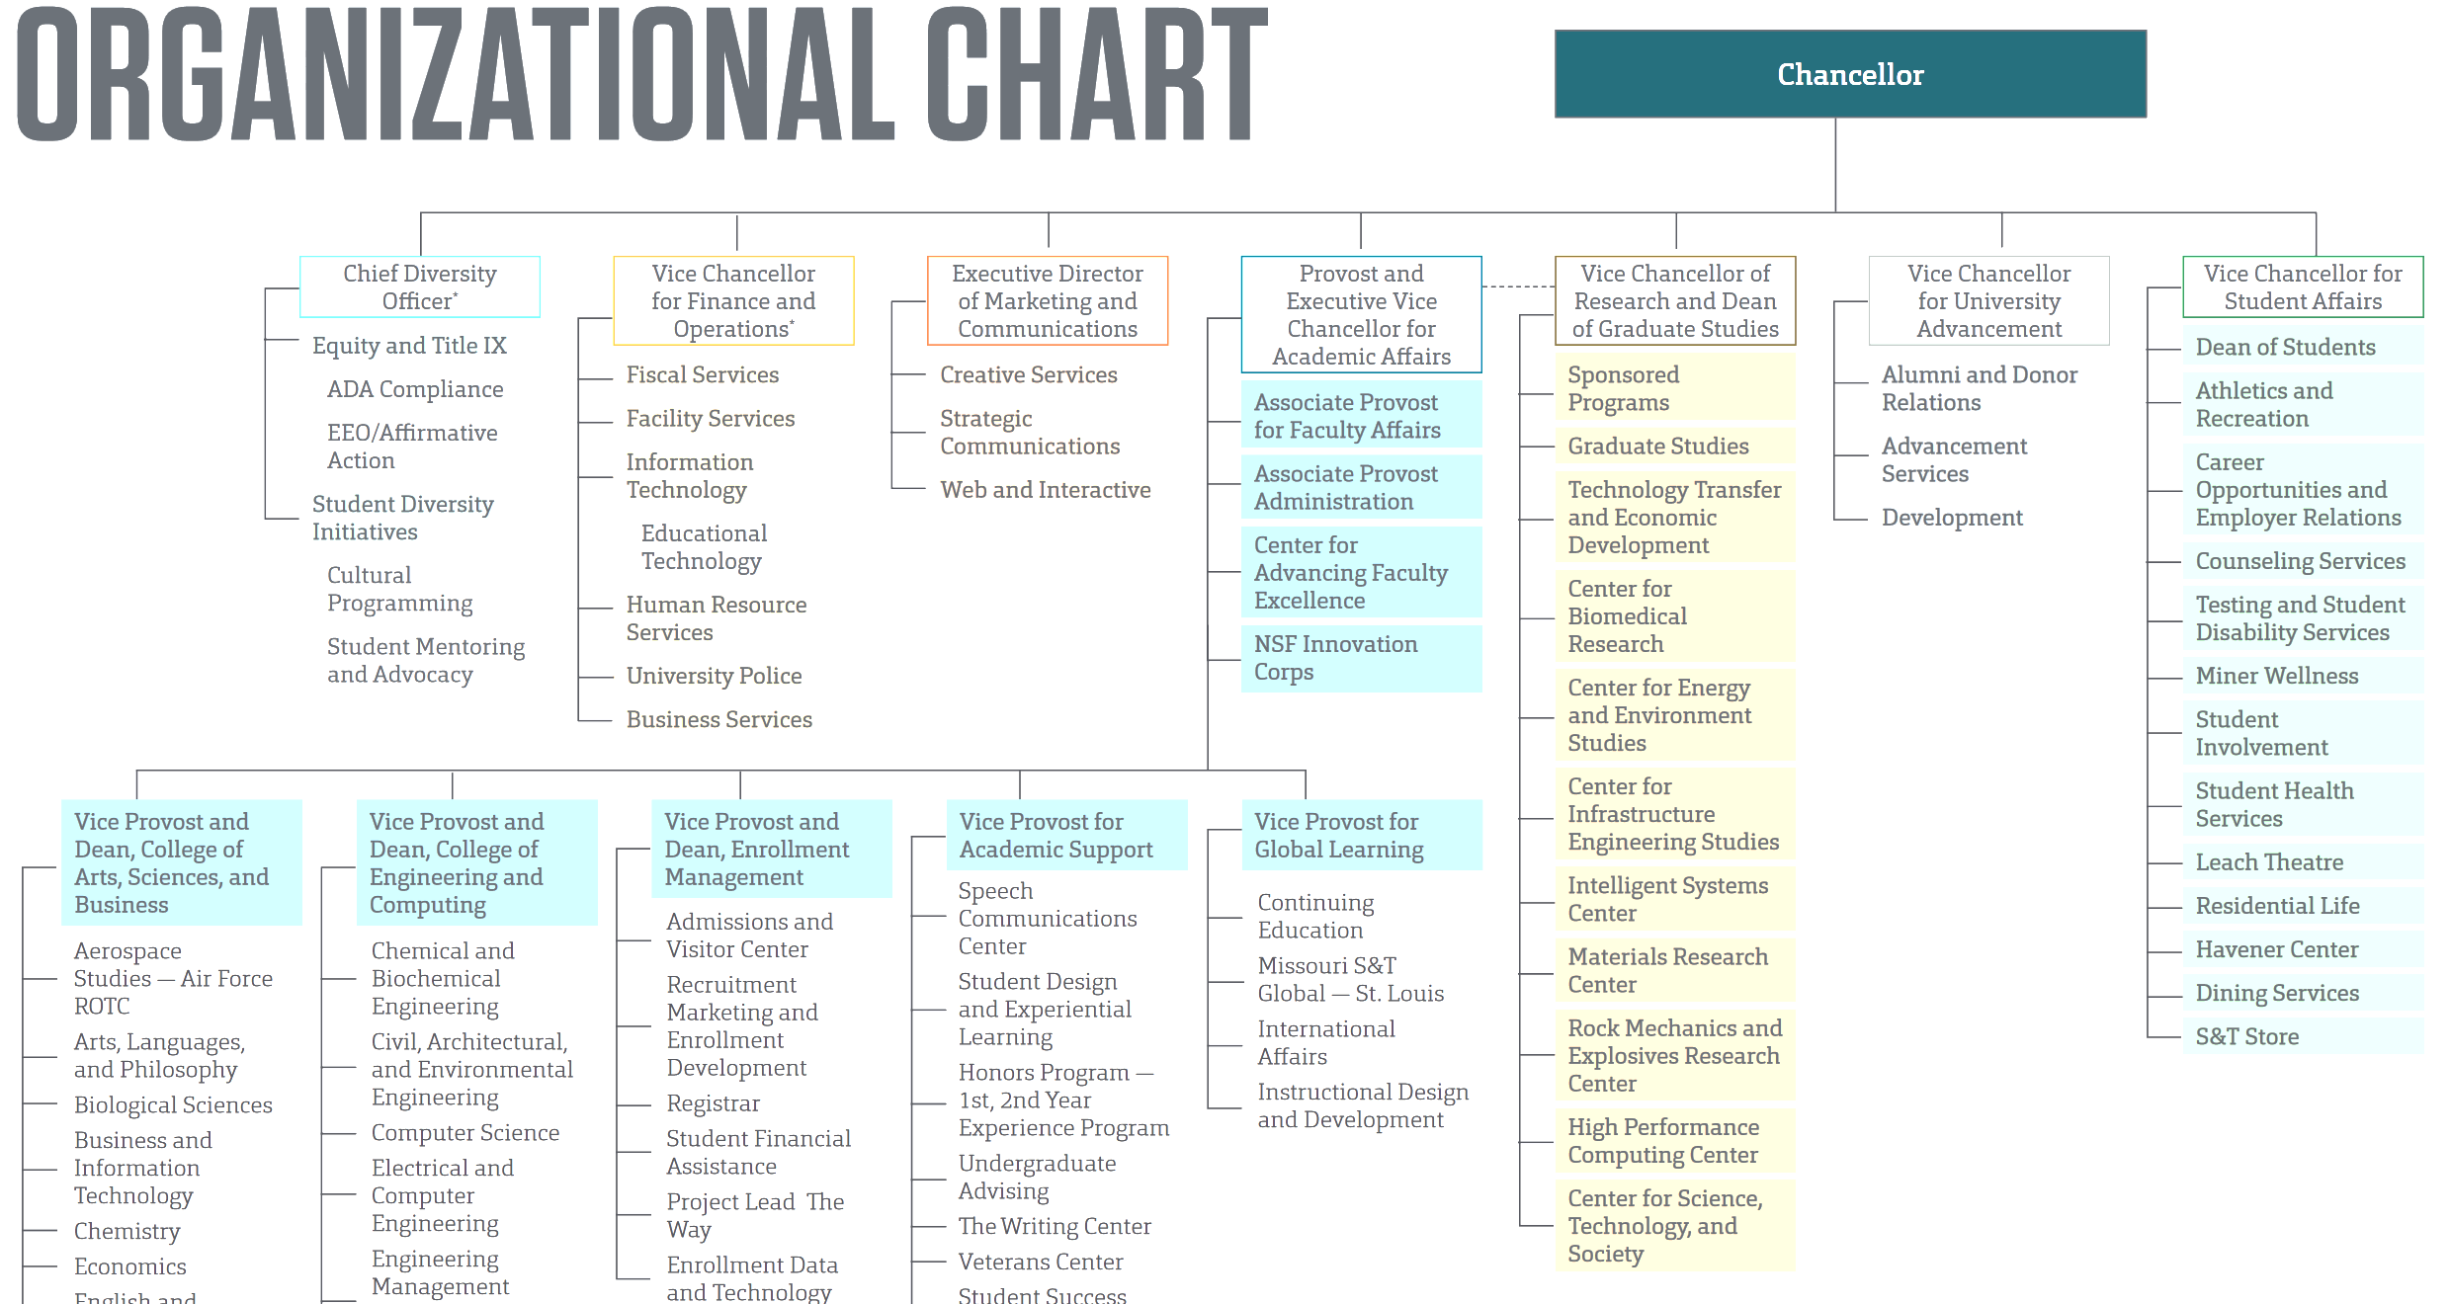
Administrators above grade 13

Slide 5
Administrators per FS officers

Slide 6
“Faculty” is nowhere defined
In this report (342 people):
Curator’s Distinguished Professor
Curator’s Distinguished Teaching Professor
Professor, Research Professor, Teaching Professor
Associate Professor, Associate Research Professor, Associate Teaching Professor
Assistant Professor, Assistant Research Professor, Assistant Teaching Professor
F&O suggested all in job area Teaching and Research, add 12 people: Lecturer, Librarian, Program Director, Teaching Fellow

Slide 7
Arguable and Hinky
Raises calculated as 1 Sept compared to 1 Sept prior year, not total pay over one year compared to prior year
Market adjustments/retention packages are not raises
Not promotions ($3/6k and $5/10k), post-tenure review awards ($5k)
Temporary pay increase for administrative duties = +10% (Yes, -10% when out, but one negotiated permanent increase)
Admin is 12-month, faculty is 9-month w/o summer; value comparisons not appropriate
One faculty member 20.1% increase, President Choi personally interested and approved
One administrator TPI of 9% in Sep, then TPI of 15% in Dec

Slide 8
FY 18 Raises in excess of 0%
If ‘raise’ = new budget funds, nobody
0 of 16 (0%) Admin
29 total positions, 8 turned over, created 2 new aVC
% additional duteis: 4.55ª
% position changes/equity: 19.86e, 32.28, 15.80, 16.65
7/14 (50%) Chairs
19 total paid positions (+2 ROTC not), ~5 turned over (Why not 22? New department)
% “raises”: 14, 1.9, 3.0+2.7j, 8.8+2.1j; 2.82, 0.29, 12.7, 0.01
34/335 (10%) Faculty
Increases in 12 of 19 departments
% raises: 1.2, 0.9j, [4.1e, 4.3e,] [1.9e, 3.1e, 3.4e,] [0.45, 0.58, 1.07, 0.47, 0.97,] [2.77, 3.44, 0.53, 0.49,] [0.22, 1.15,] 0.86, [2.43, 0.60,] [0.40, 0.31, 0.35, 2.23,] [3.04, 4.55, 0.46, 2.41, 1.40, 2.23, 1.15, 1.16,] 1.4
% raises: 4.55, 4.3e, 4.1e, 3.44, 3.4e, 3.1e, 3.04, 2.77, 2.43, 2.41, 2.23, 2.23, 1.9e, 1.40, 1.40, 1.20, 1.16, 1.16, 1.15, 1.07; 0.97, 0.9j, 0.86, 0.60, 0.58, 0.53, 0.49, 0.47, 0.46, 0.45, 0.40, 0.35, 0.31, 0.22
365 =202 (CEC) +164 (CASB) total positions, ~30 turned over
ª = additional duties, not 10%
^{j} = Jan 2018 raise
^{e} = equity
Bracket: one dep’t

Slide 9
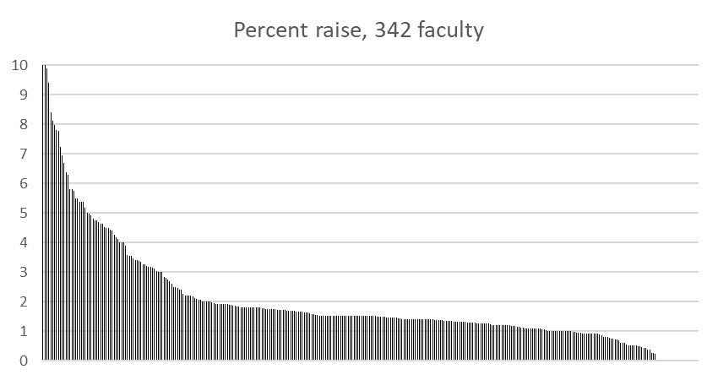
FY 19 Faculty Raises
Percent raise
Average = 2.02%
Median = 1.50%
22 Faculty,
6.4%, at zero

Slide 10
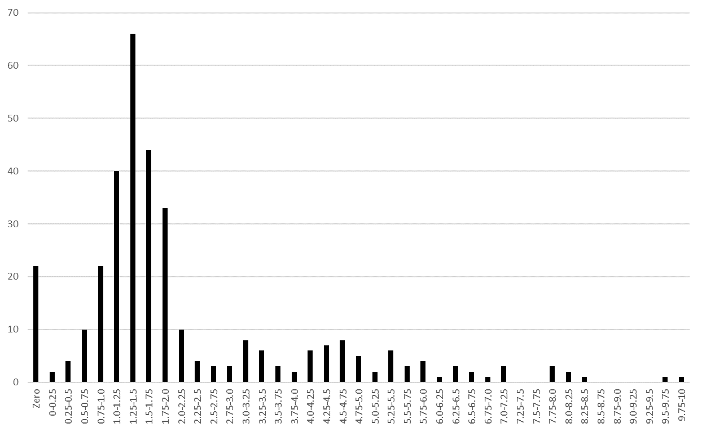
FY 19 Faculty Raises
Count

Slide 11
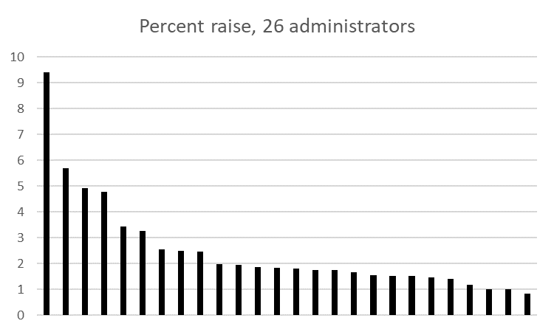
FY 19 Administrator Raises
Percent raise
Average = 2.49%
Median = 1.81%
No administrators
at zero

Slide 12
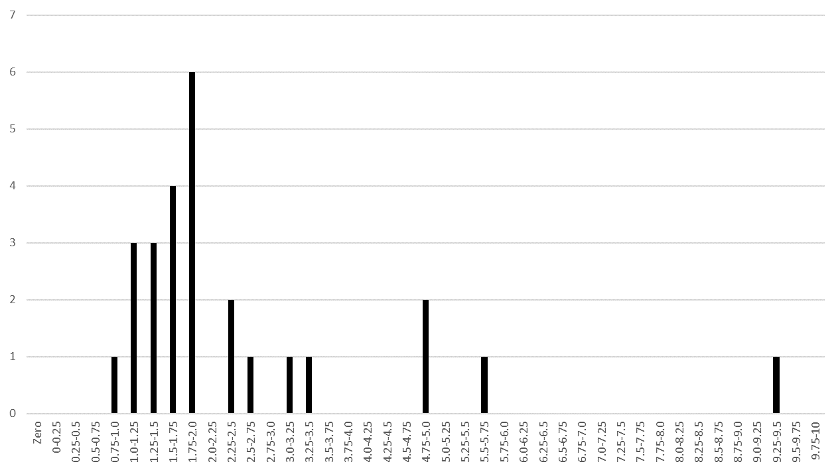
FY 19 Administrator Raises
Count

Slide 13
Comparison
Percent raise
Average = 2.02%
Median = 1.50%
Average = 2.49%
Median = 1.81%

Slide 14
Comparison
Count (different scales)
Percent raise

Slide 15
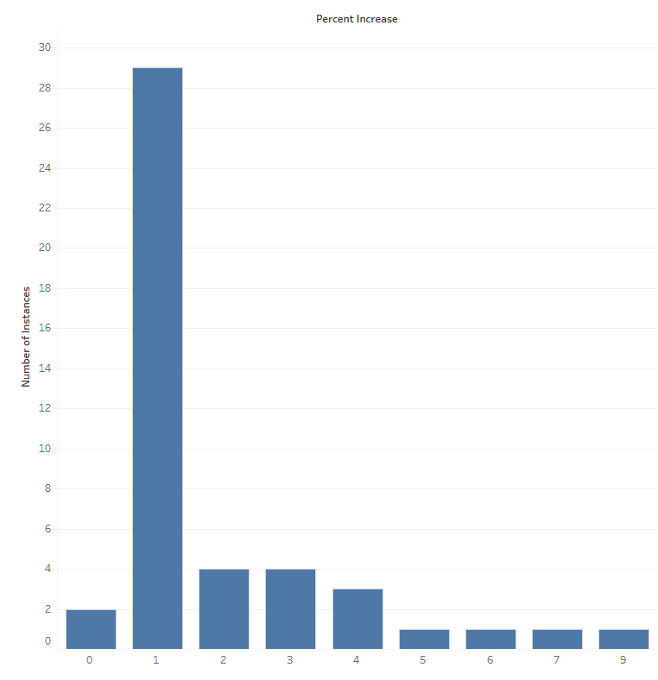
Pay Increases for Continuing Employees F&O provided. 46 administrators

Slide 16
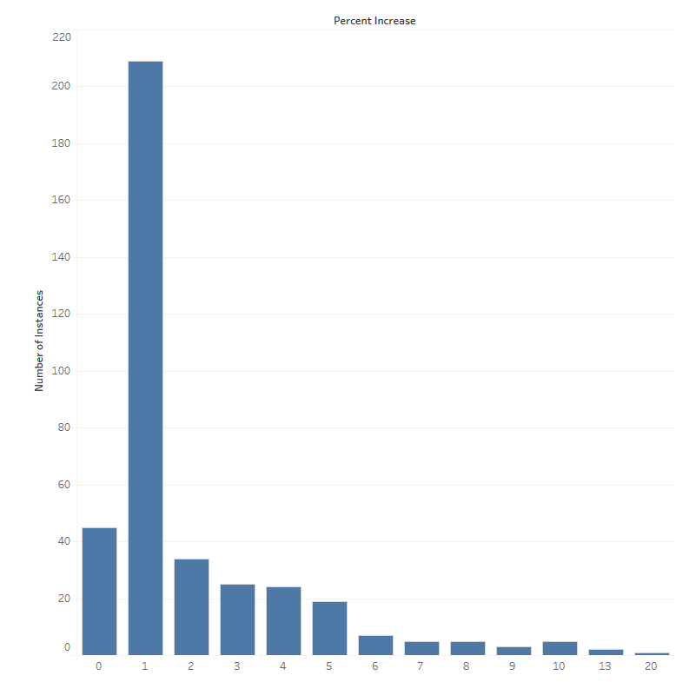
Pay Increases for Continuing Employees F&O provided. 46 administrators, 384 faculty (but the 22 at zero not included)

Slide 17
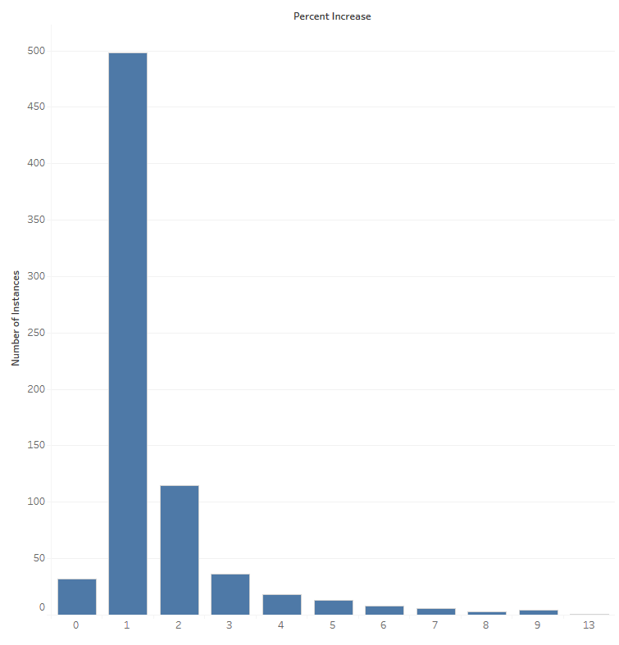
Pay Increases for Continuing Employees F&O provided. 46 administrators, 384 faculty (but the 22 at zero not included), 734 staff

